Slide 1
Sequence to Sequence Learning with Neural Networks
Ilya Sutskever
Oriol Vinyals
Quoc V. Le
2014

Slide 2
A little Trivia
The 3 authors were all in Google when they wrote this paper.
Two of them left Google 2 years after this paper was written
Ilya Sutskever
Oriol Vinyals
Co-Founder and Research Director at OpenAI

Slide 3
Background introduction
Neural network is a power model.
Pro: Perform arbitrary parallel computation for a number of steps
Con: Require that the dimensionality of the inputs and outputs is known and fixed.
Domain-dependent
Way to fix this drawback
A straightforward application of the Long Short-Term Memory (LSTM) architecture that can solve general sequence to sequence problems

Slide 4
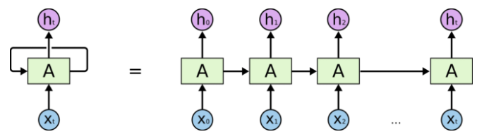
Model
Recap for RNN
Notes:
can be thought of as multiple copies of the same network, each passing a message to a successor.
chain-like network
recurrent neural networks are intimately related to sequences and lists.
natural architecture of neural network to use for such data.

Slide 5
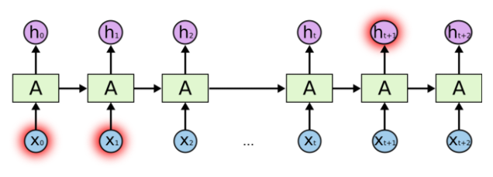

Model
Problem of long-term dependencies
($X_{t}:Present input,H_{t}$: Present output)
Notes:
In this paper
translate English to French, it need the model to be able to connect the pervious information many time steps ago to the present task.
Can RNN do this. It depends.
Sometimes, we only need to look at recent information to perform the present task. In such cases, where the gap between the relevant information and the place that it’s needed is small, RNNs can learn to use the past information.
But there are also cases where we need more context. It’s entirely possible for the gap between the relevant information and the point where it is needed to become very large.

Slide 6
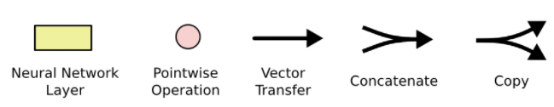
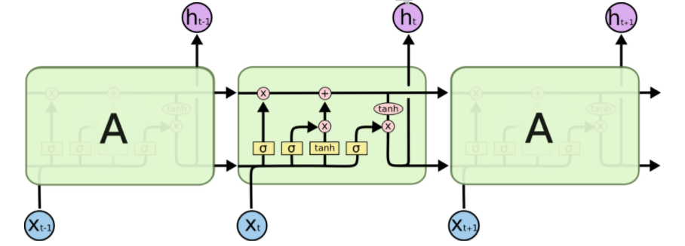
Model
LSTMs are explicitly designed to avoid the long-term dependency problem
Notes:
LSTMs are explicitly designed to avoid the long-term dependency problem.
Remembering information for long periods of time
Just like RNN, it has these repeating modeules
More complicated than RNN

Slide 7
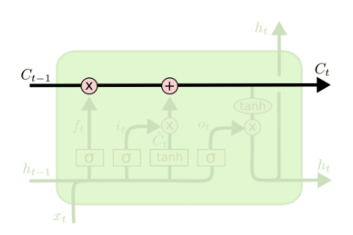

Model
The Core Idea Behind LSTMs
($C_{t}:Present Cell State$, $C_{t−1}:Pervious Cell State$)
Notes:
cell state
conveyor belt.
runs straight down the entire chain,
only some minor linear interactions.
It’s very easy for information to just flow along it unchanged.

Slide 8
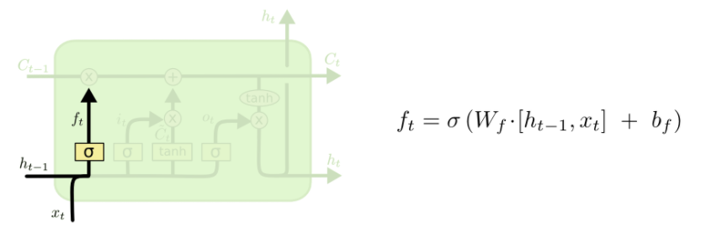

Model
The Core Idea Behind LSTMs
($X_{t}:Present input,H_{t−1}:Previous output$)
Notes:
decide what information we’re going to throw away
forget gate layer
0 and 1
Gender of subjects

Slide 9
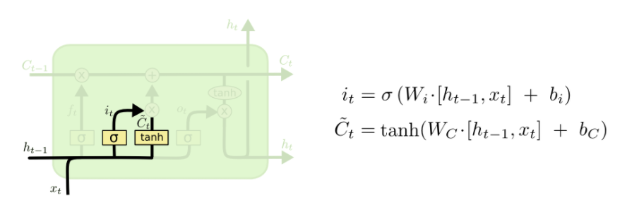
Model
The Core Idea Behind LSTMs
($X_{t}:Present input,H_{t−1}:Previous output$)
Notes:
decide what new information we’re going to store in the cell state
Sigmoid: input gate layer
Tnah: a vector of new candidate values

Slide 10
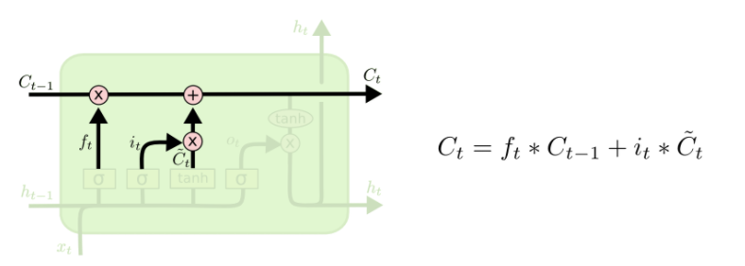
Model
The Core Idea Behind LSTMs
($C_{t}:Present Cell State$, $C_{t−1}:Pervious Cell State$)
Notes:
update the old cell state to new cell state
Forget useless
Add new candidate value , scaled

Slide 11
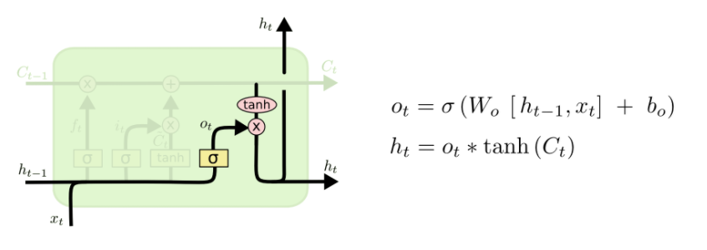

Model
The Core Idea Behind LSTMs
($X_{t}:Present input,H_{t−1}:Previous output,$ $H_{t}:Present output$)
Notes:
What we going to output
Flitered version
Sigmoid layer decide what part
Put cell though tanh
-1 to 1
Get the part we actually want

Slide 12
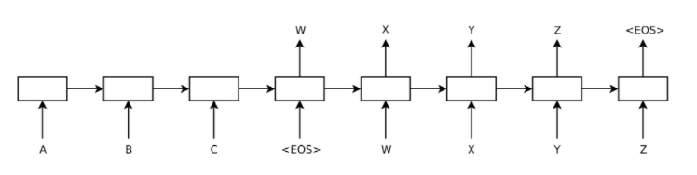
Improvement on traditional LSTM
Using two different LSTMs
- one for the input sequence and another for the output sequence,
Notes:
use one LSTM to read the input sequence, one timestep at a time, to obtain large fixed-dimensional vector representation,
use another LSTM to extract the output sequence from that vector.
The second LSTM is essentially a recurrent neural network language model except that it is conditioned on the input sequence.
The LSTM’s ability to successfully learn on data with long range temporal dependencies

Slide 13
Improvement on traditional LSTM
Reversing the order of the words of the input sentence
- One of the key technical contributions of this work.
- Introduction of many short term dependencies to the dataset.
- That makes it easy for SGD to “establish communication” between the input and
the output.
Notes:
concatenate a source sentence with a target sentence, each word in the source sentence is far from its corresponding word in the target sentence. As a result, the problem has a large “minimal time lag”
By reversing the words in the source sentence, the average distance between corresponding words in the source and target language is unchanged.
the first few words in the source language are now very close to the first few words in the target language, so the problem’s minimal time lag is greatly reduced.

Slide 14
Experiment
And demo

Slide 15
datasets
WMT’14 English to French dataset
http://www.statmt.org/wmt14/translation-task.html
Subset of 12M sentences consisting of 348M French words and 304M English words
Vocabulary:160,000 of the most frequent words for the source language and 80,000 of the most frequent words for the target language.
Every out-of-vocabulary word was replaced with a special “UNK” token.
Ulrich UNK , membre du conseil d’ administration du constructeur automobile Audi , affirme qu’ il s’ agit d’ une pratique courante depuis des anne ́es pour que les te ́le ́phones portables puissent eˆtre collecte ́s avant les re ́unions du conseil d’ administration afin qu’ ils ne soient pas utilise ́s comme appareils d’ e ́coute a` distance .
Ulrich Hackenberg , membre du conseil d’ administration du constructeur automobile Audi , de ́clare que la collecte des te ́le ́phones portables avant les re ́unions du conseil , afin qu’ ils ne puissent pas eˆtre utilise ́s comme appareils d’ e ́coute a` distance , est une pratique courante depuis des anne ́es .

Slide 16
Training details
Deep LSTMs VS shallow LSTMs
Deep LSTM wins!
Each additional layer reduced perplexity by nearly 10%,
possibly due to their much larger hidden state.
4 layers, with 1000 cells at each layer and 1000 dimensional word embedding

Slide 17
More training details
Datasets contains sentences with different lengths:
short (e.g., length 20-30) or long (e.g., length > 100
minibatch of 128 randomly chosen training sentences will have many short sentences and few long sentences, and as a result, much of the computation in the minibatch is wasted.
To address this problem, we made sure that all sentences within a minibatch were roughly of the same length, which a 2x speedup.

Slide 18
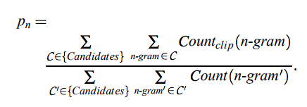
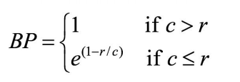
bleu
http://www.aclweb.org/anthology/P02-1040.pdf
Automatic Evaluation of Machine Translation
To judge the quality of a machine translation, one measures its closeness to one or more reference human translations according to a numerical metric.
BLEU = geometric mean of N-gram precision (p) x Brevity Penalty (BP),
BP is for penalizing the candidate translation (c) that are shorter than the reference translations (r)
Notes:
A source sentence could be translated as multiple target sentences
Procedure in the case of corpus evaluation:
Compute the N-gram matches sentence by sentence
Add the clipped counts for all candidate sentences
Divide the sum by the total number of n-grams in the test corpus

Slide 19
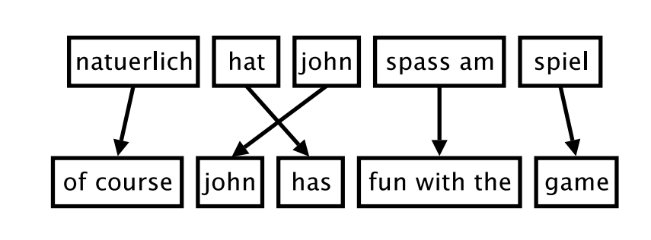
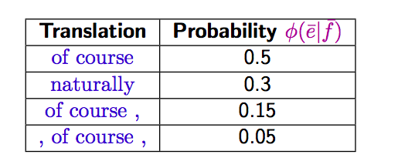
phrased-based SMT
Phrase Translation Table
Notes:
Foreign input is segmented in phrases •
Each phrase is translated into English •
Phrases are reordered
Main knowledge source: table with phrase translations and their probabilities

Slide 20
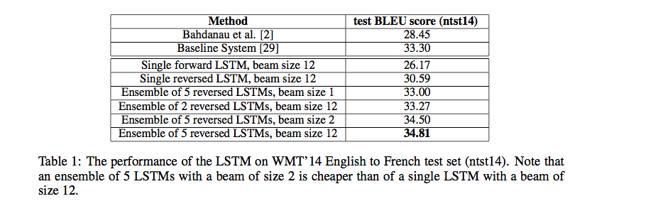
Experiments and results
1-2: RNN ENCODER–DECODER for SMT
3-6: different kinds of LSTM with different amounts of LSTM and beam size
Notes:
Statistical machine translation which we used as a baseline
29: a German university’s implementation and datasets

Slide 21
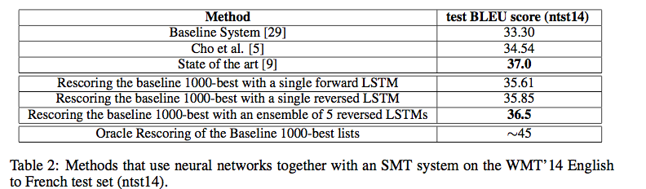
results
State of art: phrase-based SMT from Nadir Durrani, Barry Haddow, Philipp Koehn, and Kenneth Heafield. Edinburgh’s phrase-based machine translation systems
Notes:
LSTMs that differ in their random initializations and in the random order of minibatches
1000-best rescore: a way to tune thw weights by ranking the 1000 best results and pass it to optimizer

Slide 22
Results
Performance:
decoded translations of the LSTM ensemble do not beat the state of the art
inability to handle out-of-vocabulary words
BUT!:
first time that a pure neural translation system outperforms a phrase-based SMT baseline on a large MT task
Improvements on the LSTM RNN models
Notes:
The LSTM is within 0.5 BLEU points of the previous state of the art by rescoring the 1000-best list of the baseline system.

Slide 23
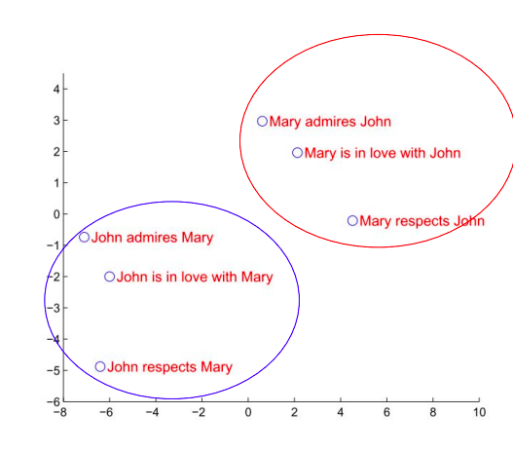
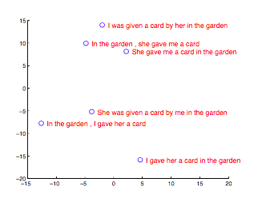
performance
Notes:
One of the attractive features of our model is its ability to turn a sequence of words into a vector of fixed dimensionality.
The phrases are clustered by meaning, which in these examples is primarily a function of word order, which would be difficult to capture with a bag-of-words model. Notice that both clusters have similar internal structure.
The figure clearly shows that the representations are sensitive to the order of words, while being fairly insensitive to the replacement of an active voice with a passive voice

Slide 24
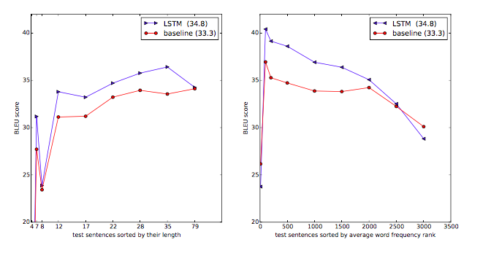
Performance
Notes:
No degradation of performance until sentence length longer than 35 words
Performance degrade with the increasing number of rare words in test sentence

Slide 25
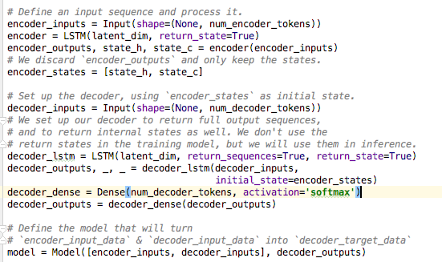
demo
Keras + tensorflow
- An encoder LSTM
- A decoder LSTM is trained to turn the target sequences into the same sequence but offset by one timestep in the future.
Effectively, the decoder learns to generate targets[t+1...]` given `targets[...t]`, conditioned on the input sequence..
Notes:
An encoder LSTM turns input sequences to 2 state vectors in the encoder_states: h and c - A decoder LSTM is trained to turn the target sequences into the same sequence with the encoder states

Slide 26
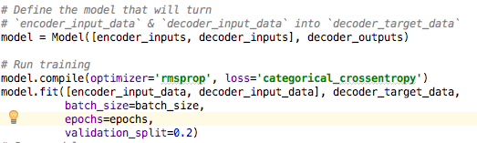
dataset
http://www.manythings.org/anki/cmn-eng.zip
Chinese – English sentence pairs datasets
batch_size = 64 # Batch size for training. epochs = 80 # Number of epochs to train for. latent_dim = 256 # Latent dimensionality of the encoding space. num_samples = 10000 # Number of samples to train on.
Input clarification
tokenize
Encoder LSTM
Decoder LSTM
Model fitting (training)

Slide 27
result
Epoch 1/80
8000/8000 [==============================] - 98s 12ms/step - loss: 1.3300 -
Epoch 2/80
8000/8000 [==============================] - 95s 12ms/step - loss: 0.9390 -
Epoch 3/80
8000/8000 [==============================] - 94s 12ms/step - loss: 0.8090 –
…..
Epoch 80/80
8000/8000 [==============================] - 103s 13ms/step - loss: 0.1723
About 2 hours to run
Each epoch takes 90 secs
Input sentence: Call me.
Decoded sentence: 联系我
Input sentence: Join us.
Decoded sentence: 来加入我们吧。
Input sentence: Grab Tom.
Decoded sentence: 抓住汤姆。
Input sentence: Grab him.
Decoded sentence: 抓住他。
Notes:
Information loss/perplexity decrease
Possible to overfit

Slide 28
Result cont
Input sentence: Let's go!
Decoded sentence: 讓我們斓學忡。
Input sentence: Tom died.
Decoded sentence: 汤姆拥抱了他的父亲。（Tom hugged his father）
Input sentence: I'm sick.
Decoded sentence: 我是個老師。（I am a teacher）
Input sentence: I'm busy.
Decoded sentence: 我很忙。
Input sentence: I'm cold.
Decoded sentence: 我很忙。
Notes:
Words that doesn’t exist in the corpus/training data
Similar structure
Limited num of samples, chinese is a very complicated
Limited time and device to run

Slide 29
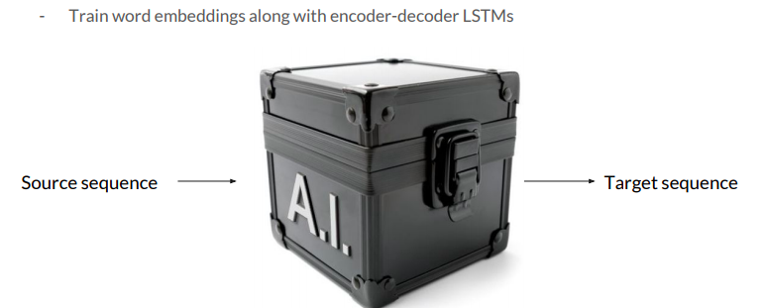
Summary
PROS:
Lots of Tricks to Improve Performance: deep LSTM, Reversing the source sentence
Applicable for Various Sequence to Sequence Tasks
End-to-end Neural Network Model

Slide 30
Summary
Cons:
Need better results comparison
Weak explanation on some claims
Claim 1: Reverse input for better performance due to short term dependencies to dataset
Claim 2: Surprise on better performance with longer sentence
Claim 3: Sensitive to word order
Claim 4: Insensitive to active/passive word replacement
No comparison across multiple languages

Slide 31
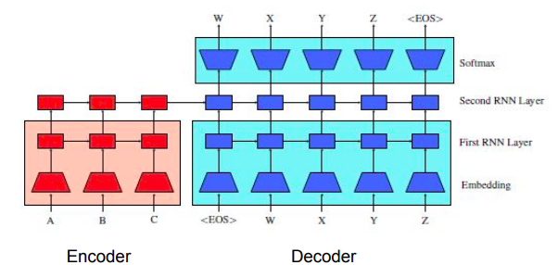
New Seq2Seq improvements
Unsupervised Pretraining for Seq2Seq [Le 2016]
Pretrained Seq2Seq encoder and decoder weights (First RNN Layer)

Slide 32
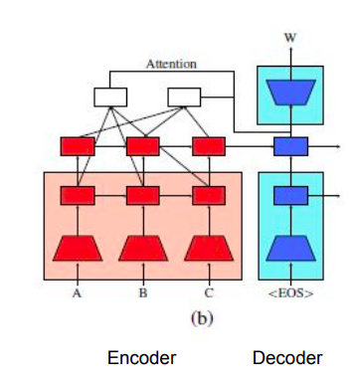
Even more
Attention Model at multiple layers

Slide 33
references
Sequence to Sequence Learning with Neural Networks, Le et al, 2014. https://arxiv.org/pdf/1409.3215.pdf
Understanding LSTM Networks, http://colah.github.io/posts/2015-08-Understanding-LSTMs/
Learning Phrase Representations using RNN Encoder–Decoder for Statistical Machine Translation, Cho et al, 2014, https://arxiv.org/pdf/1406.1078.pdf
BLEU: a Method for Automatic Evaluation of Machine Translation, Papineni et al, 2002, http://www.aclweb.org/anthology/P02-1040.pdf
Unsupervised Pretraining for Sequence to Sequence Learning, Le et al, 2016. https://arxiv.org/pdf/1611.02683.pdf

Slide 34
Thank you for listening!

